Slide 1

UNIVERSITY INSTITUTE OF ENGINEERING
DEPARTMENT OF AIT - CSE
Bachelor of Engineering (CSE)
Security and Data Privacy Laws and Standards (21CSF-433)
By: Ms. Merry K.P(E12903)
Assistant Professor
AIT CSE
Lecture-12
Protecting Programs and Data & Information and Law
DISCOVER . LEARN . EMPOWER

Slide 2
Chapter | Course Objectives
1.3 | Understand the unique challenges posed to law enforcement agents, policy makers and prosecutors
Chapter | Course Outcomes
1.3 | After completion of this course, the student will be able to Describe the legal requirements for the use of Trusted data, data collection, and storage.

Slide 3
Contents
1.3 Legal, Privacy and Ethical Issues in Computer Security
Protecting Programs and Data

Slide 4
Trademarks

Slide 5
Fundamental of Trademark
A trademark is a word, symbol, slogan, or other identifier that identifies the source of a good or service in the marketplace.
Trademarks allow a consumer to quickly associate a product with the company that produced it and make a purchasing decision based on prior experience with that company or product.
Definition of Trademark Under Indian Trade Mark Act, 1999.
Sec. 2 (zb) “trade mark” means a mark capable of being represented graphically and which is capable of distinguishing the goods or services of one person from those of others and may include shape of goods, their packaging and combination of colors.

Slide 6
Types of Trademark
Traditional Trademarks: Traditionally trademarks can be defined as any mark which is unique to the product and was identified with the origin of the product.
These marks would usually be word marks, device marks, numeral etc.
Non-Traditional trademarks: A type of trademark which does not fall into the category of conventional or traditional trademarks.
An unconventional trademark is mainly in the form of sound marks, smell marks, shape marks or color marks. An unconventional mark must possess the communicative ability of being able to differentiate the goods and services of one person from that of another.

Slide 7
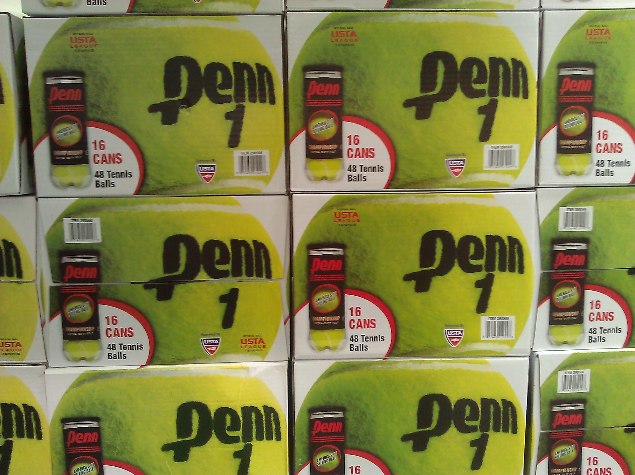
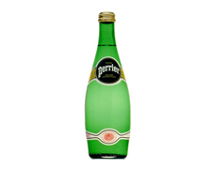
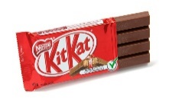
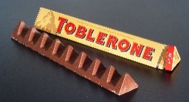
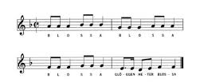

Shape Marks
Costco Tennis Ball (Smell marks)
Sound Marks
Color Marks

Slide 8
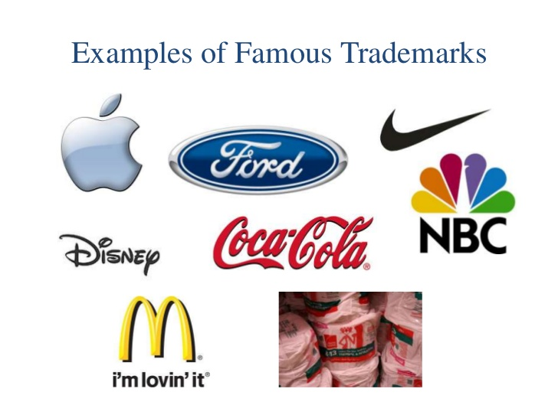
Categories of Mark
Generally, there are three :
Trademark: A trademark is a word, logo, device, symbol, or combination of these and identifies the source of a product or good.
A trademark may be located on a package, a label, a voucher, or on the product itself.

Slide 9
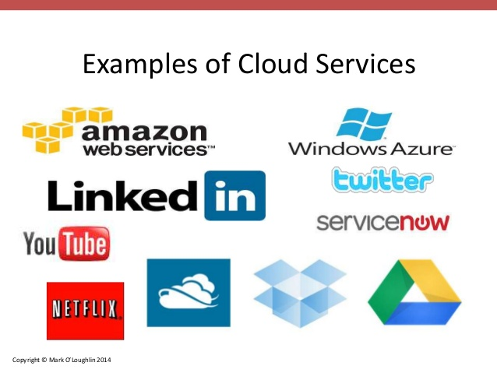
Categories of Mark
Service mark: A service mark is similar to a trademark except it identifies the provider of a service rather than a product.
Service marks are a subset of trademarks and are oftentimes referred to as trademarks. Examples -Amazon.com (retail service), UPS (delivery service), and Infosys (IT consulting).
Because there is no product or packaging to mark, service marks are generally seen on advertising, uniforms, vehicles, and the like.

Slide 10
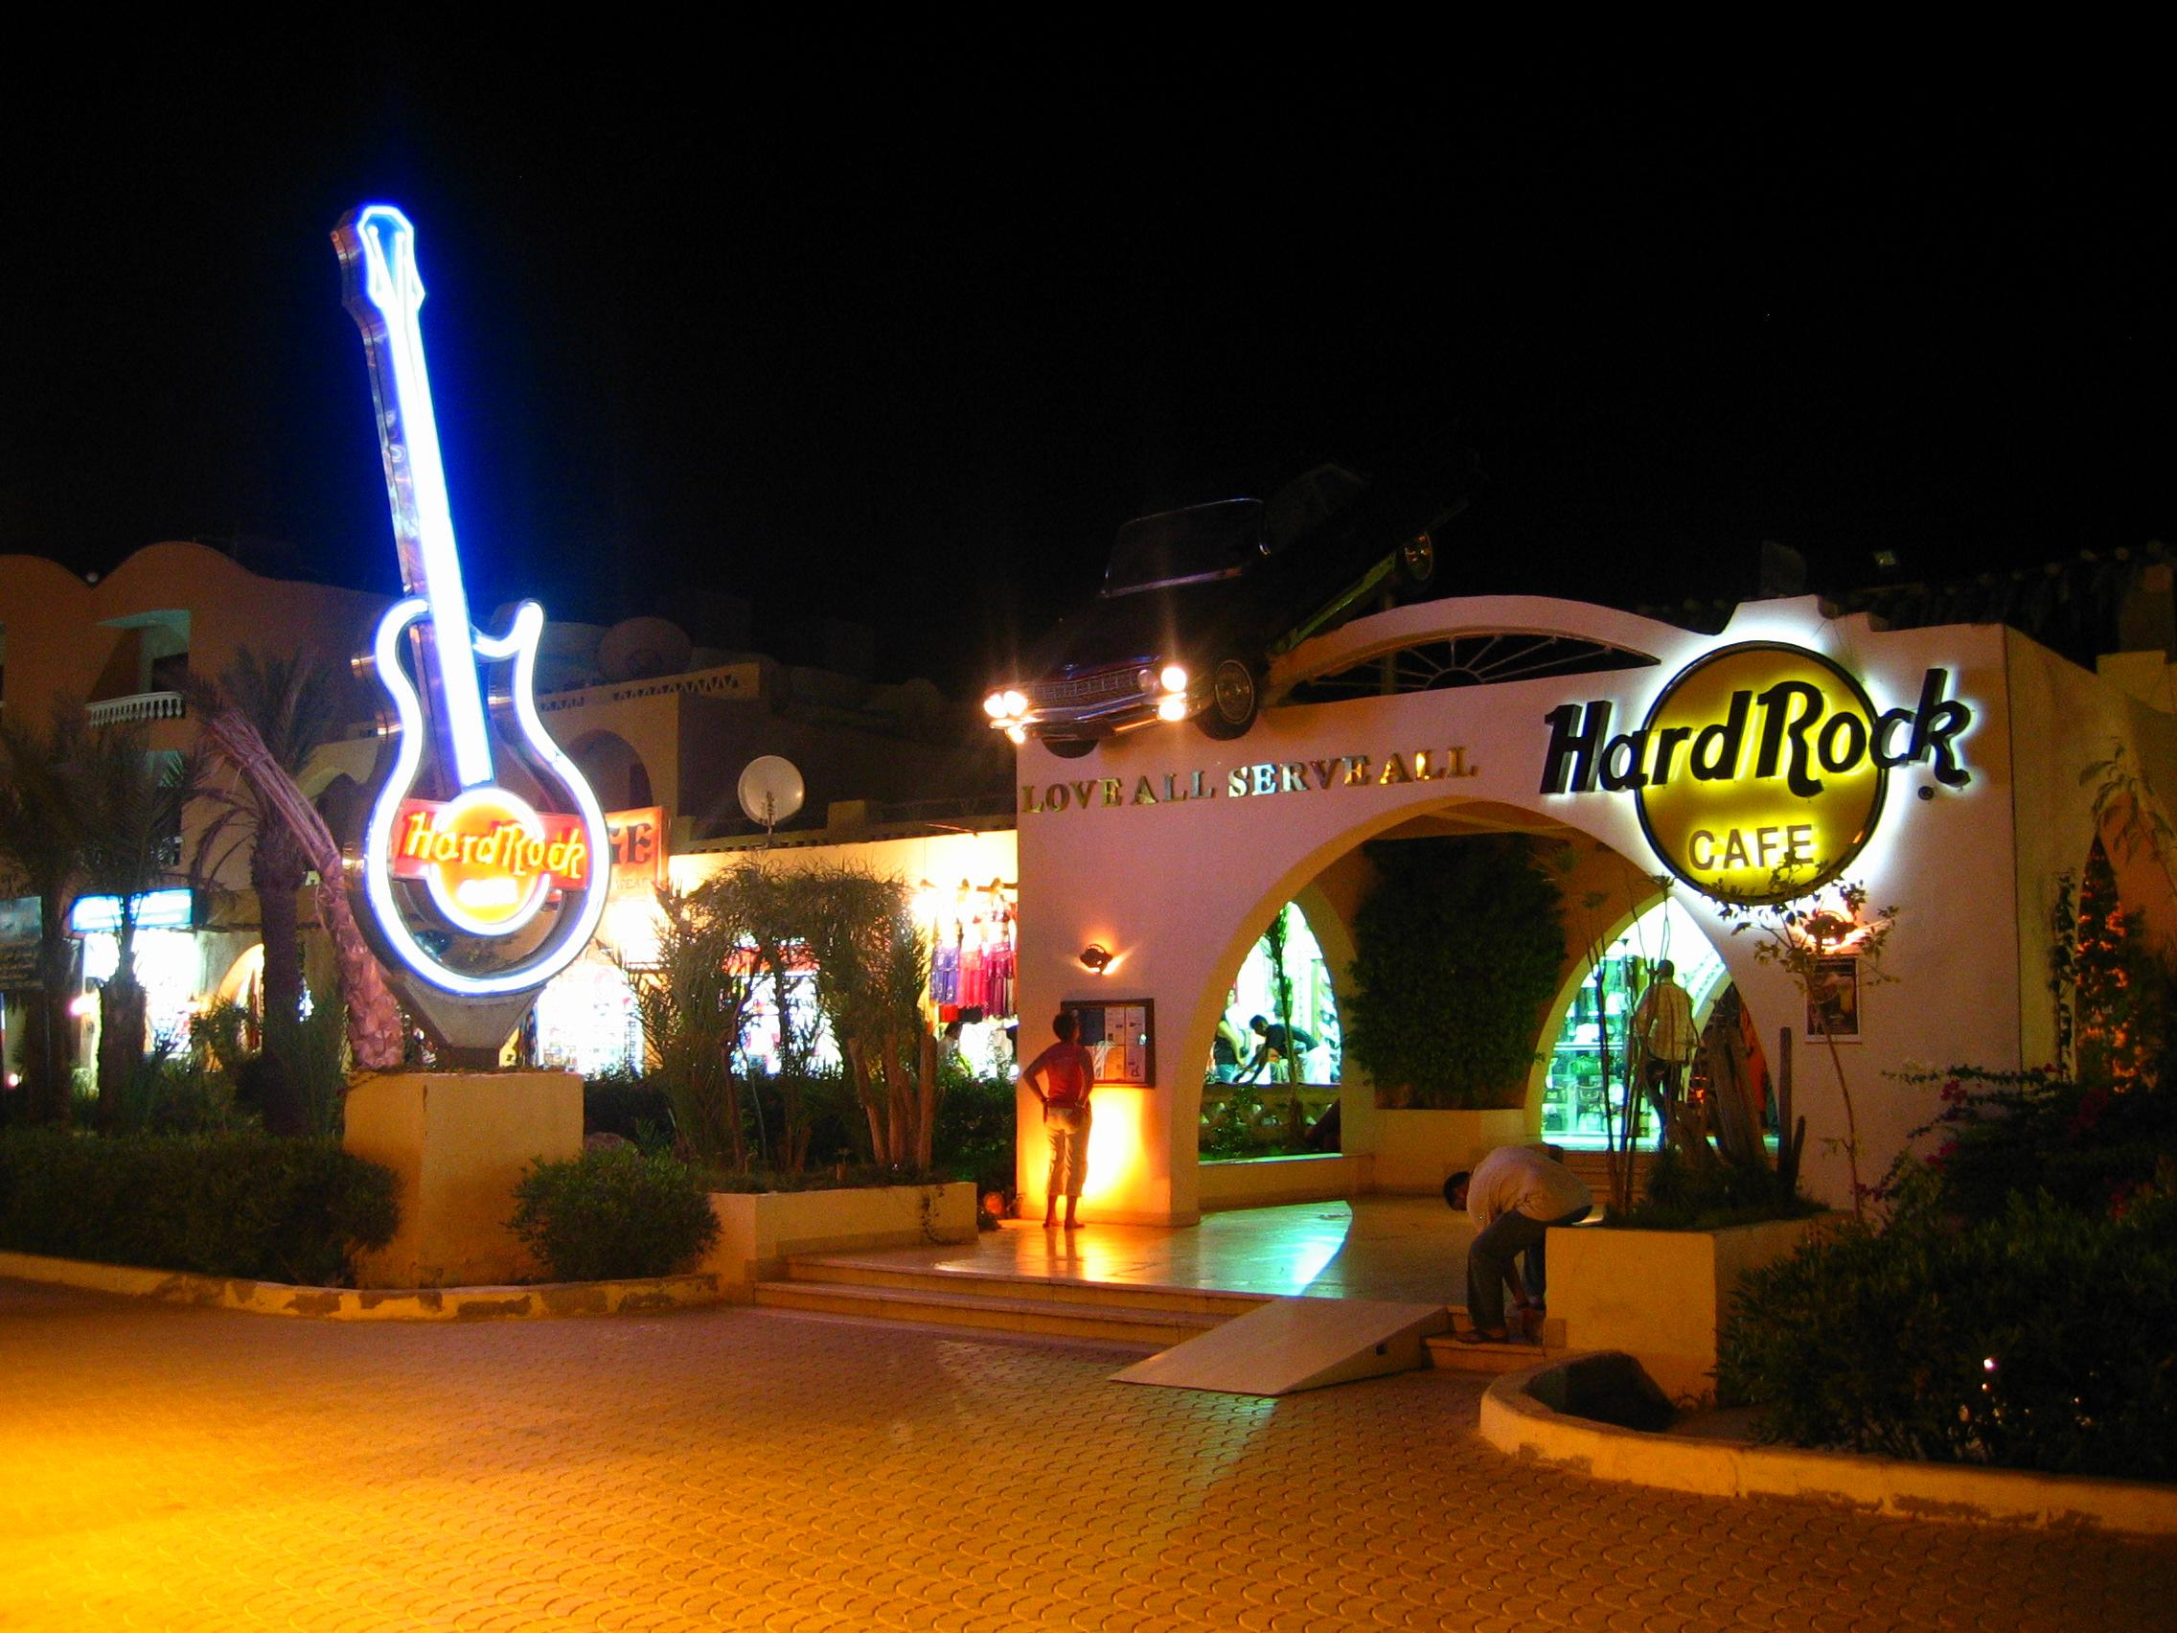
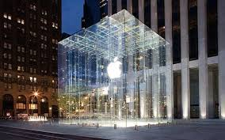
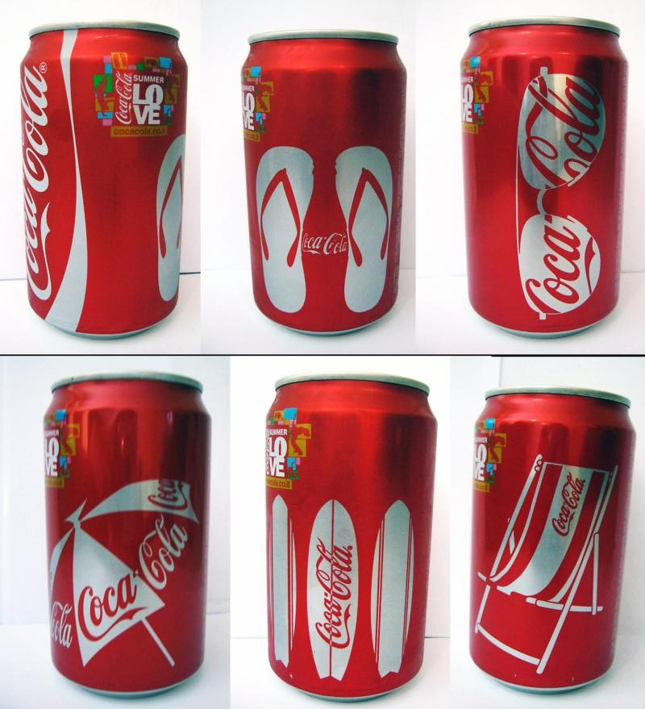
Categories of Mark
Trade dress: A trade dress protects elements of a product or its packaging, including color, size, shape, aroma and flavor.
Examples include the distinctive shape and decoration of a restaurant, the color of insulation, or the shape of a beverage container etc.

Slide 11
Selection of a Strong Trademark
The selection of the mark will be important from the point of view of registration time and infringement issues in the future. According to base of the selection the Trademarks can be classified/ depend on:
Fanciful or Coined Marks
Arbitrary Marks
Suggestive Marks
Descriptive Marks
Generic Marks
Here 1 indicates type of very strong trademark while 5 indicates type of very weak trademark.

Slide 12
Classification of Trademark
1. Fanciful or Coined Marks: They are known as Invented/ Coined Mark with no dictionary meaning. Examples-SONY, NOKIA and KODAK etc.
2. Arbitrary Marks: Such marks have a meaning but they are applied to a product or service that is unrelated to that meaning. Examples-APPLE for Computers, SHELL for Petroleum, Camel for cigarettes and BLACKBERRY for Mobile.
3. Suggestive Marks: Such marks uses some quality or characteristic of the products or services, in connection with which they are used but they DO NOT have any direct reference. They require some imagination, thought, or perception to reach a conclusion. Example-MICROSOFT (suggestive of software for microcomputers) INFOSYS (Info. means Information), Welspun (Spun)
4. Descriptive Marks: They direct indication of nature of the products or services without imagination, thought, or perception. Protection Allowed–If mark Acquired Distinctive character. Example–APPLE for Box of an apple, TUBELESS for computer monitors, COLD AND CREAMY for ice cream etc.
Example of Acquired Distinctive mark- Pizza Hut, AIRBUS for airplanes & Burger King
5. Generic Marks: This mark are actual name a product or services. Example-WATCH, SMARTPHONE, SOCIAL NETWORK, Escalator, E-MAIL etc.

Slide 13



Symbolic Representation of various marks Logo

Slide 14
Trademarks Registration Process in India

Slide 15
TM Search
TM Filing
Examination Report (Objection or Acceptance)
Reply to Objection (Examination Report) (With 1 month)
Hearing before the Examiner

Slide 16
Acceptance of mark
Publication for 4 months
Opposition, if any
If no Opposition, Registration
Renewal of the Mark (10 year from the date of filing)

Slide 17
Trademarks Goods and Service Classifications
According to Section-7,
The Register shall classify goods and services, as far as may be , in accordance with the international classification of goods and services (NICE CLASSICATION) for the purposes of registration of Trade Marks.
Any question arising as to the class within which any goods or services falls shall be determined by the Registrar whose decision shall be final.
The classes are categorized in:
1 to 34 (Goods)
35 to 45 (Services)
One may refer the European Union Intellectual Property Office (EUIPO) link : http://euipo.europa.eu/ec2/ for categories information of the various classes.

Slide 18
Filing Authority and Location
Any person, claiming to be the proprietor of a trademark used or proposed to be used by him, may apply in writing in prescribed manner for registration.
Territorial Jurisdictions of TMR Offices:
MUMBAI (HEAD OFFICE) : The State of Maharashtra, Madhya Pradesh, Chhattisgarh and Goa
AHMEDABAD : The State of Gujarat and Rajasthan and Union Territories of Daman, Diu, Dadra and Nagar Haveli.
KOLKATA : The State of Arunachal Pradesh, Assam, Bihar, Orissa, West Bengal, Manipur, Mizoram, Meghalaya, Sikkim, Tripura, Jharkhand and Union Territories of Nagaland, Andaman & Nikobar Islands.
NEW DELHI : The state of Jammu & Kashmir, Punjab, Haryana, Uttar Pradesh, Himachal Pradesh, Uttarakhand, Delhi and Union Territories of Chandigarh
CHENNAI : The state of Andhra Pradesh, Telangana, Kerala, Tamilnadu, Karnataka and Union Territories of Pondicherry and Lakshadweep Island
Please refer: http://www.ipindia.nic.in/form-and-fees-tm.htm

Slide 19
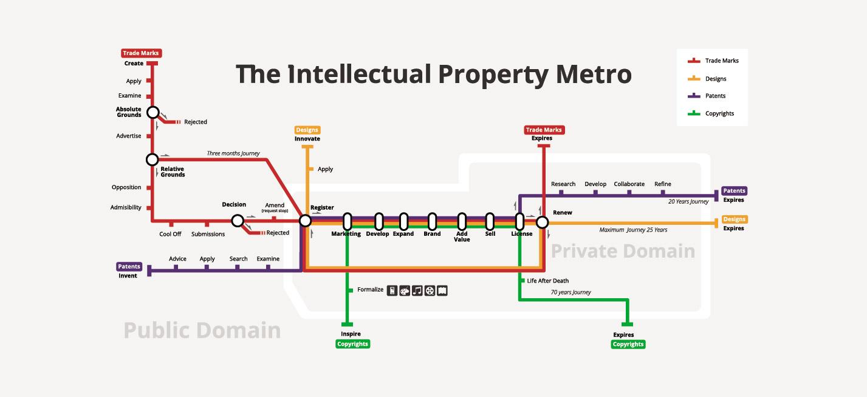
Intellectual Property Life Cycle

Slide 20
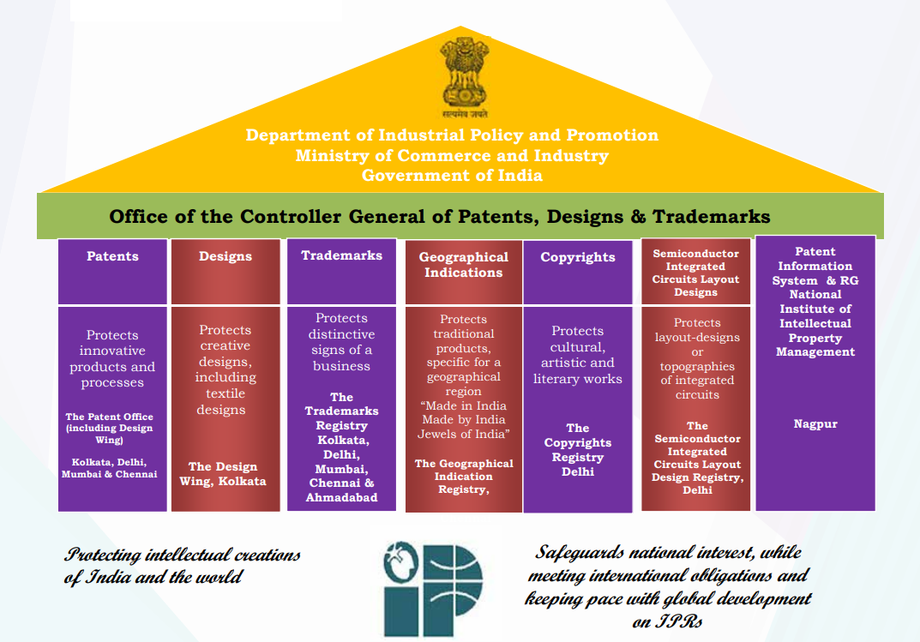

Slide 21
 | Copyright | Patent | Trade Secret
Protects | Expression of idea in a work | Invention the way something works | A secret, competitive advantage
A protected object made public | Yes, the intention is to promote the publication | Design filed at Patent Office | No
Requirement to distribute | Yes | No | No
Ease of filing | Easy to publish | Its bit complex | No filing
Duration | Life of human originator plus 70 years, or a total of 95 years for a company | 19 years (if it's published) or else 8 years | Indefinite
Legal protection | Sue if unauthorized copy sold | Sue if invention copied | Sue if secret improperly obtained

Slide 22
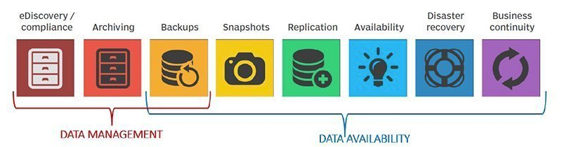
Data

Slide 23
Summary
Awareness about data protections
Security Protecting Programs and data

Slide 24
Home Work
Q1. What is a Trademark? Who may apply for registration of a trademark?
Q2. What is the essential information required for an application for registration of trademark (s) in
India?

Slide 25
References
Text Books:
V. D. Dudeja ,”Cyber Crime and Law Enforcement”, Commonwealth Publishers, 2003.
C. Davis,”IT Auditing: Using Controls to protect Information Assets”, TMH, 2011.
Reference Books:
Paul van Oorschot, computer Security and the Internet: Tools and Jewels (2020, Springer). Personal use copy freely available on author's web site.
Wenliang Du, Computer Security: A Hands-on Approach (2017, self-published). Updated May 2019.
Online References:
What is Data Protection and Why Do You Need It?: https://www.youtube.com/watch?v=SuNtmCgIhiM
Data Protection in Software Development: https://www.youtube.com/watch?v=mxusGZtPLos

Slide 26
THANK YOU
For queries
Email: merry.e12903@cumail.in

